Slide 1

Introduce Cloud

Slide 2







Introduce Cloud
Cloud Computing
AWS
AWS Servies

Slide 3
I. Cloud Computing

Slide 4
I. Cloud Computing
What is Cloud Computing?
Cloud computing is the delivery of computing services, including servers, storage, databases, networking, software, analytics, and intelligence over the Internet (“the cloud”) to offer faster innovation, flexible resources, and economies of scale.
Rather than keeping files on a proprietary hard drive or local storage device, cloud-based storage makes it possible to save them to a remote database. As long as an electronic device has access to the web, it has access to the data and the software programs to run it.

Slide 5
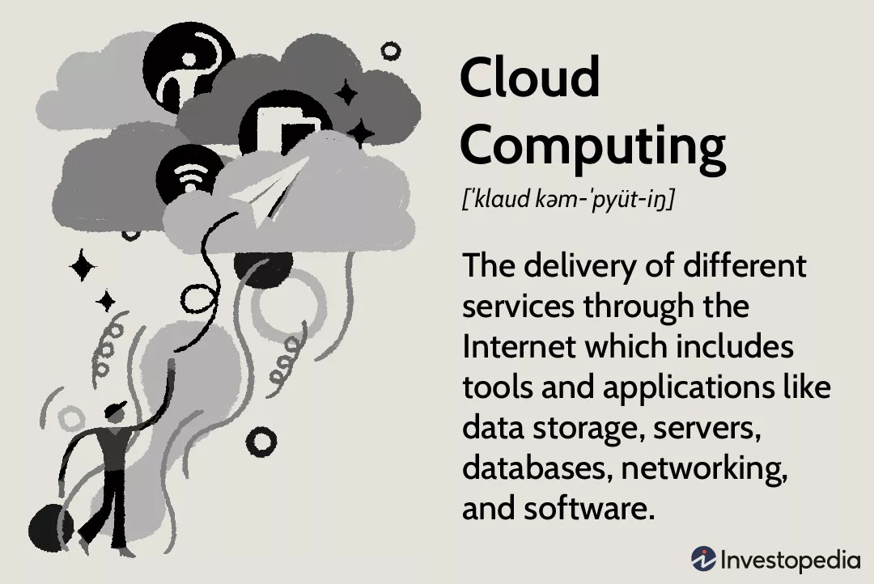
I. Cloud Computing
What is Cloud Computing?

Slide 6
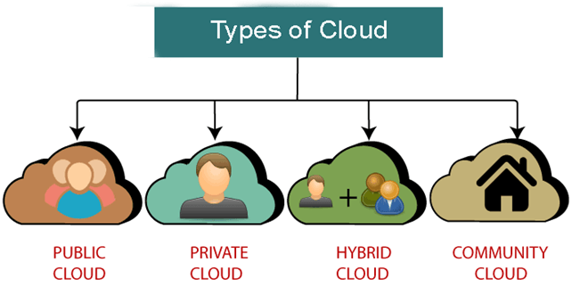
I. Cloud Computing
Types of Cloud

Slide 7
I. Cloud Computing
Types of Cloud
Public clouds provide their services on servers and storage on the Internet. These are operated by third-party companies, who handle and control all the hardware, software, and the general infrastructure. Clients access services through accounts that can be accessed by just about anyone.
Private clouds are reserved for specific clientele, usually one business or organization. The firm's data service center may host the cloud computing service. Many private cloud computing services are provided on a private network.

Slide 8
I. Cloud Computing
Types of Cloud
Hybrid clouds are, as the name implies, a combination of both public and private services. This type of model allows the user more flexibility and helps optimize the user's infrastructure and security.
Community clouds are built for the purpose of sharing infrastructure and data for many different organizations and users. For example, businesses operating in the education industry can share a cloud to exchange data for each other.

Slide 9
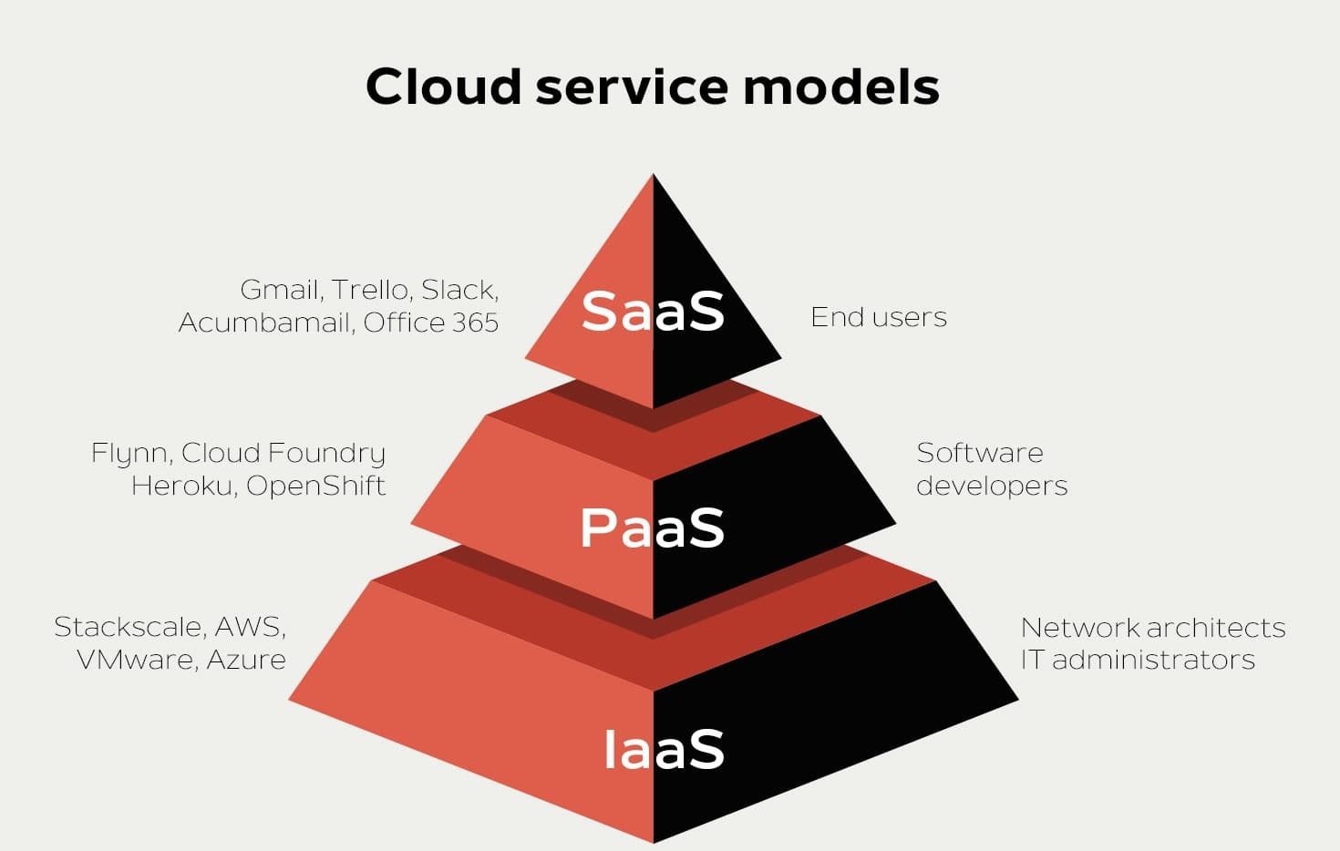
I. Cloud Computing
Cloud service models

Slide 10
I. Cloud Computing
Cloud service models
Software-as-a-service (SaaS) involves the licensure of a software application to customers. Licenses are typically provided through a pay-as-you-go model or on-demand. This type of system can be found in Microsoft Office's 365.

Slide 11
I. Cloud Computing
Cloud service models
Platform-as-a-service (PaaS) is considered the most complex of the three layers of cloud-based computing. PaaS shares some similarities with SaaS, the primary difference being that instead of delivering software online, it is actually a platform for creating software that is delivered via the Internet. This model includes platforms like Salesforce.com and Heroku.

Slide 12
I. Cloud Computing
Cloud service models
Infrastructure-as-a-service (IaaS) involves a method for delivering everything from operating systems to servers and storage through IP-based connectivity as part of an on-demand service. Clients can avoid the need to purchase software or servers, and instead procure these resources in an outsourced, on-demand service. Popular examples of the IaaS system include IBM Cloud and Microsoft Azure.

Slide 13
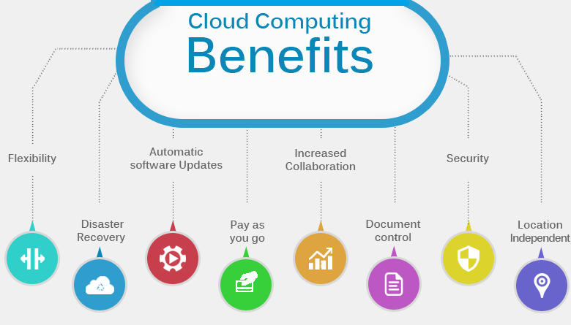
I. Cloud Computing
Cloud Computing Benefits

Slide 14
I. Cloud Computing
Cloud Computing Benefits
Cost savings: Helps minimize costs. You will not spend money on the original infrastructure. For example: Buy hardware, software, system installation, ...
Convenience: Users can quickly access and use resources via the Internet without complicated installation
Safe and continuous: All data is synchronized in the cloud. Help ensure higher safety, avoid data loss due to hard drive damage. In addition, the supplier will back up and have security methods to better protect data.
Deploy quickly anywhere: With just a few simple steps to deploy them everywhere. This means that users will get a better experience with lower latency.

Slide 15

I. Cloud Computing
Who needs to use Cloud Computing?
Cloud computing can be used for anyone:
Companies, businesses, organizations wishing to store and share data.
Website developers, applications, software.
End users (individual users).

Slide 16
I. Cloud Computing
Cloud Service providers
Google Cloud
Amazon Web Services (AWS)
Microsoft Azure
IBM Cloud
Alibaba Cloud

Slide 17
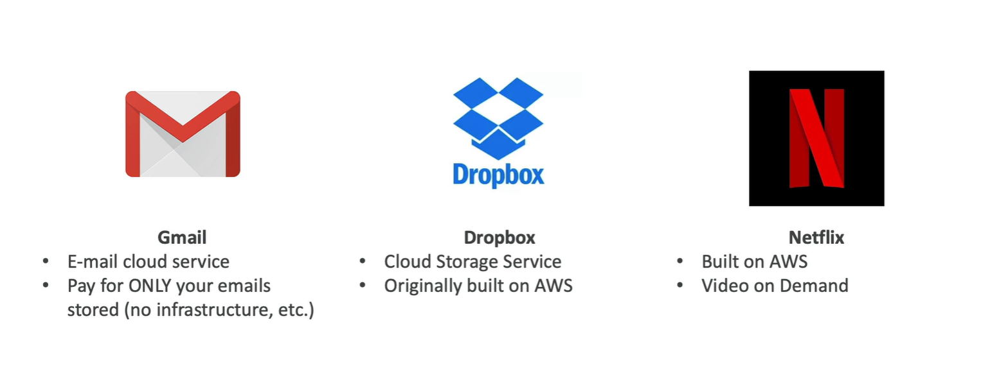
I. Cloud Computing
Example of Cloud Computing
Today, there are several examples of cloud computing applications used by both businesses and individuals. One type of cloud service would be streaming platforms for audio or video, where the actual media files are stored remotely. Another would be data storage platforms like Google Drive, Dropbox, OneDrive, or Box.

Slide 18
II. AWS

Slide 19

II. AWS
What is AWS?
AWS
AWS Meaning: The Amazon Web Services (AWS) platform provides more than 200 fully featured services from data centers located all over the world, and is the world's most comprehensive cloud platform.
Amazon web service is an online platform that provides scalable and cost-effective cloud computing solutions.
AWS is a broadly adopted cloud platform that offers several on-demand operations like compute power, database storage, content delivery, etc., to help corporates scale and grow.

Slide 20
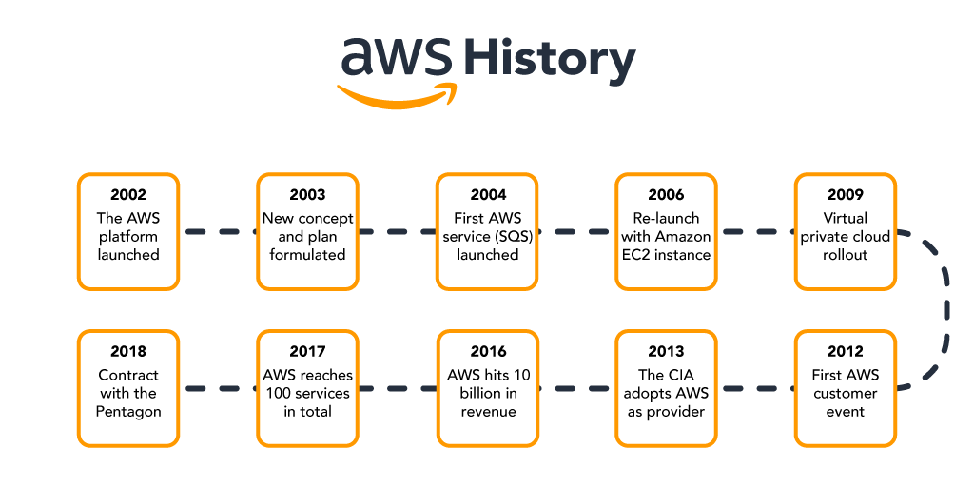
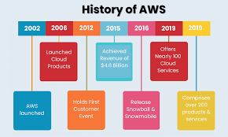
II. AWS
AWS
History of AWS

Slide 21
II. AWS
History of AWS
AWS
2002 - The platform was launched
2003 - Concept was reformulated with standardized plans
2004 - The first service (Simple Queue Service) launched for public usage
2006 - Official re-launch with Amazon EC2
2009 - Virtual Private Cloud launches
2012 - Holds first customer event
2013 - CIA adoption
2016 - Reaches 10 billion in revenue target
2017 - 100 services in total
2018 - Signs 10 billion dollar contract with the Pentagon

Slide 22
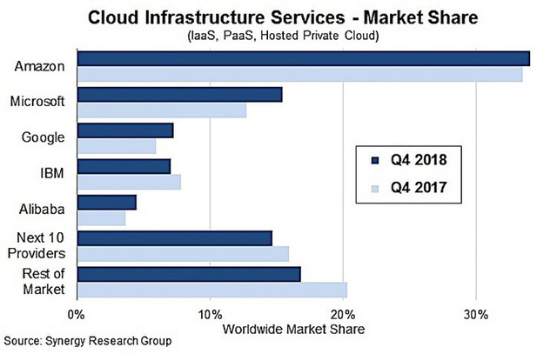
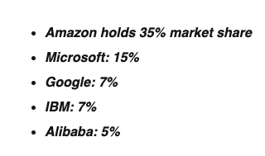
II. AWS
In 2018, the cloud compuIn 2018, the cloud computing service market thrived when businesses spent up to 70 billion USD on cloud services.ting service market thrived when businesses spent up to 70 billion USD on cloud services.
Cloud Infrastructure Services
In 2018, the cloud computing service market thrived when businesses spent up to 70 billion USD on cloud services.

Slide 23
II. AWS
AWS
Advantages of AWS
AWS provides a user-friendly programming model, architecture, database as well as operating system that has been already known to employers.
AWS is a very cost-effective service. There is no such thing as long-term commitments for anything you would like to purchase.
It offers billing and management for the centralized sector, hybrid computing, and fast installation or removal of your application in any location with few clicks.
There is no need to pay extra money on running data servers by AWS.
AWS offers a total ownership cost at very reasonable rates in comparison to other private cloud servers.

Slide 24
II. AWS
AWS
Disadvantages of AWS
AWS has supportive paid packages for intensive or immediate response. Thus, users might need to pay extra money for that.
There might be some cloud computing problems in AWS especially when you move to a cloud Server such as backup protection, downtime, and some limited control.
From region to region, AWS sets some default limitations on resources such as volumes, images, or snapshots.
If there is a sudden change in your hardware system, the application on the cloud might not offer great performance.

Slide 25
II. AWS
AWS
Applications of AWS
Application Hosting/SaaS Hosting
Sharing Media (Image/ Video)
Hosting Website
Content Delivery and Media Distribution
Social Networking
Storage, Backup, and Disaster Recovery
Development & Testing Environments
Social Networking
Academic Computing
Search Engines
Mobile and Social Applications

Slide 26
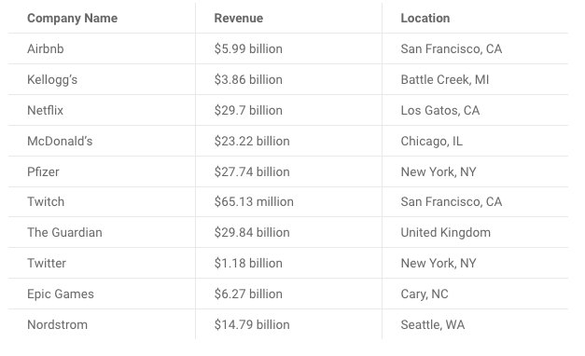
II. AWS Services
AWS
Most successful companies that use AWS

Slide 27
III. AWS Services

Slide 28
II. AWS Services
AWS
Why to use AWS Services
AWS offers more solutions and features than any other provider and has free tiers with access to the AWS Console, where users can centrally control their ministrations.
Designed around ease-of-use for various skill sets, AWS is tailored for those unaccustomed to software development utilities. Web applications can be deployed in minutes with AWS facilities, without provisioning servers or writing additional code.
Amazon hosts global data centers with a vast network ensuring reduced latency worldwide. AWS’ replication capacity allows you to duplicate services regionally, helping you recover quickly and avoid costly downtime.

Slide 29
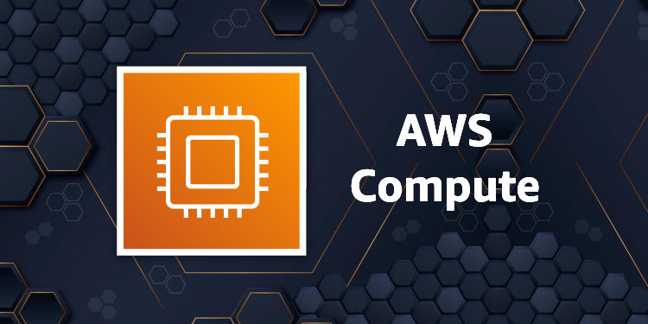
II. AWS Services
AWS
AWS Compute Services

Slide 30
II. AWS Services
AWS
AWS Compute Services
EC2 (Elastic Compute Cloud) – EC2 is a virtual machine in the cloud over which you have OS-level control. This service can run and shut down whenever needed.
LightSail – This cloud tool automatically deploys and manages the computing, storage, and networking capabilities needed to run your applications.
Elastic Beanstalk – A tool that automates deployment and provisioning of resources like a highly scalable production site.
EKS (Elastic Container Service for Kubernetes) – Tool that allows you to access Kubernetes on Amazon cloud environment without installation.
AWS Lambda – This service allows to run functions in the cloud. This tool is a big cost saver by paying only when the functions are executed.

Slide 31
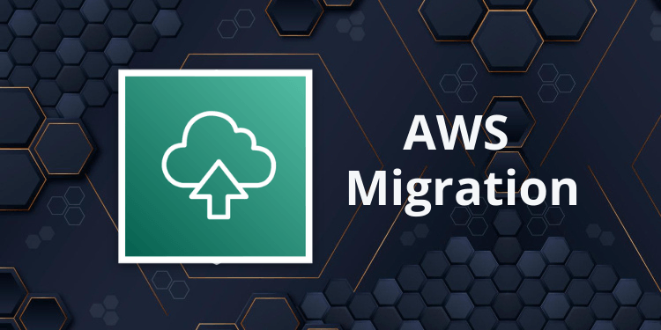
II. AWS Services
AWS
AWS Migration

Slide 32
II. AWS Services
AWS
AWS Migration
DMS (Database Migration Service) – DMS can be used to migrate on-premises databases to AWS.
SMS (Server Migration Service) – An SMS service that allows you to easily and quickly migrate on-premises servers to AWS.
Snowball – Snowball is a petabyte-scale data transport solution that uses secure appliances to transfer large amounts of data in and out of the AWS cloud .

Slide 33
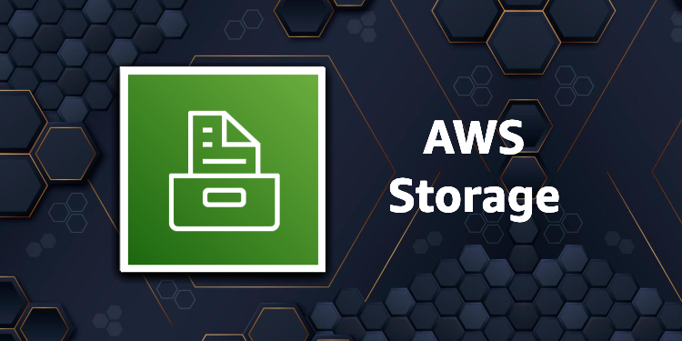
II. AWS Services
AWS
AWS Migration

Slide 34
II. AWS Services
AWS
AWS Storage Services
Amazon Glacier – This is an extremely low-cost hosting service that ensures fast and safe storage and backup of data.
Amazon Elastic Block Store (EBS) – Provides block-level storage for use with Amazon EC2 instances.
AWS Storage Gateway – This service connects on-premises software applications with cloud-based storage. Secure integration between corporate databases and AWS storage infrastructure.

Slide 35

II. AWS Services
AWS
AWS Sercurity Services

Slide 36
II. AWS Services
AWS
AWS Sercurity Services
IAM (Identity and Access Management) – IAM is a cloud security service that helps you manage users, assign policies, form groups to manage multiple users.
Inspector – This is an agent that you can install on your virtual machines, reporting any security holes.
Certificate Manager – Free SSL certificate service for your domains managed by Route53.
WAF (Web Application Firewall) – WAF security service provides application level protection and allows you to block SQL injection and help block cross-site scripting attacks.
Cloud Directory – This service allows you to create flexible, manageable root directories to decentralize data in multiple dimensions.
KMS (Key Management Service) – This is a management service. This security service helps you create and control encryption keys, which allow you to encrypt your data.
...

Slide 37
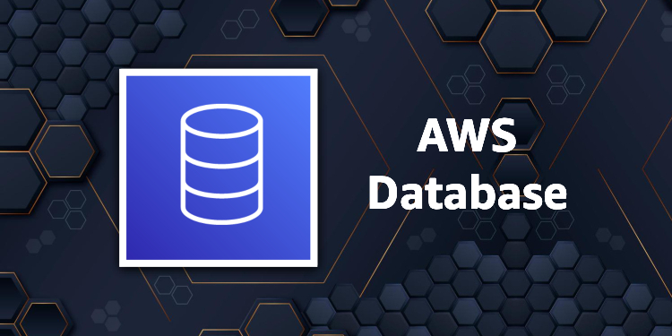
II. AWS Services
AWS
AWS Database Services

Slide 38
II. AWS Services
AWS
AWS Database Services
Amazon RDS – This service makes it easy to set up, operate, and scale a relational database in the cloud.
Amazon DynamoDB – This is a fast, fully managed NoSQL database service. It is a simple service that enables efficient data storage and retrieval.
Amazon ElastiCache – This is a web service that makes it easy to deploy, operate, and scale an in-memory cloud cache.
Neptune – This is a fast, reliable and scalable graph database service.
Amazon RedShift – This is Amazon's data warehousing solution that you can use to perform complex OLAP queries.

Slide 39

II. AWS Services
AWS
AWS Analytics Services

Slide 40
II. AWS Services
AWS
AWS Analytics Services
Athena – This analytics service allows SQL queries on S3 buckets to find files.
CloudSearch – You should use this AWS service to create a fully managed search engine for your website.
ElasticSearch – An upgraded version of CloudSearch with more features, such as application monitoring.cl
Kinesis – This AWS analytics service helps you to stream and analyze real-time data at scale.
QuickSight – It is a business analysis tool. It helps you create in-console visualizations for data in Amazon Web Services. For example: S3, DynamoDB, etc.
EMR (Elastic Map Reduce) This AWS Analytics Service is mainly used for big data processing like Spark, Splunk, Hadoop, etc.
Data Pipeline – Allows you to move data from one place to another. For example, from DynamoDB to S3.

Slide 41
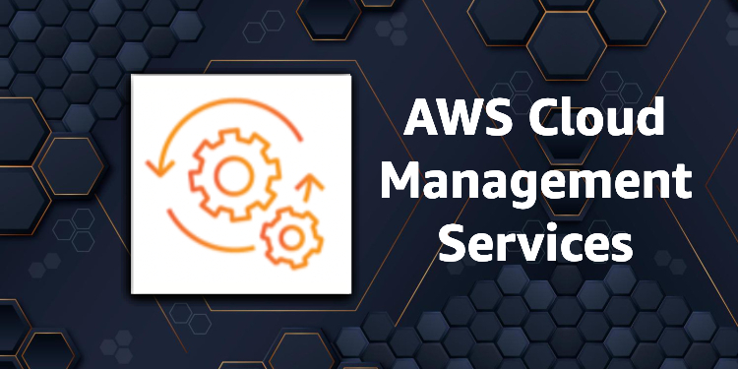
II. AWS Services
AWS
AWS Management Services

Slide 42
II. AWS Services
AWS
AWS Management Services
CloudWatch – Cloud watch helps you monitor AWS environments like EC2, RDS, and CPU usage. It also triggers alarms depending on various metrics.
CloudFormation – The service that helps set up Amazon Web Service resources, so you can spend less time managing those resources and can focus on developing applications that run on AWS .
CloudTrail – It provides an easy method to test AWS resources.
OpsWorks – Service that allows you to automatically deploy Chef/Puppet on AWS environments.
Config – The service that monitors your AWS environment. This tool will send you a notification every time you change certain configurations.
Service Catalog – This service helps large businesses to allow users to use which services and which services will not be used.
...

Slide 43
Cloud Configuration

Slide 44
Cloud Configuration
AWS EC2 Configuration
Webserver Configuration

Slide 45
I. AWS EC2 Configuration

Slide 46
I. Amazon EC2
AWS

Slide 47
I. Amazon EC2
AWS
What is Amazon EC2
Amazon Elastic Compute Cloud (Amazon EC2) is a cloud computing infrastructure powered by Amazon Web Services (AWS) that provides virtualized computing resources on demand.
Amazon EC2 provides scalable virtualized computing applications with virtual hardware components such as computer memory (ram), processors, flexibility in the choice of storage partitions data storage in different platforms and the security of service management by AWS's powerful cloud virtualization architecture.
Amazon EC2 will provide one or more virtual servers that can be combined to easily deploy the fastest application and ensure the highest availability. Even in terms of payment, you can easily know how much you need to pay based on the information about the resources you use.

Slide 48
I. Amazon EC2
AWS
What is Amazon EC2 Instance
Amazon EC2 Instanc is a cloud server. With one account you can create and use multiple Amazon EC2 Instances. Amazon EC2 Instances are run on the same physical server and share memory, CPU, hard drive...

Slide 49
I. Amazon EC2
AWS
What is Amazon EC2 Feature
Scaling:
Scaling Up/Down: Increase/Decrease capacity(RAM, CPU,...) of Instance.
Scaling In/Out: Increase/Decrease the number of Instances.
Security:
It is possible to set a private IP rank exclusively for EC2.
Use Security Group and Network ACLS to control inbound/outbound.
An IPsec VPN can be established between Data Center and AWS Cloud.
Delicated Instance -> Create EC2 on a single physical hardware for a single customer.
Cost:
On-Demand Instance: Calculated by the hour, meeting the needs of use in a short time. Use as much, pay as much.
Reserved Instance: Allows to prepay a server amount for 1 or 3 years. The cost is only 75% of On-Demand. If you don't need to use it for a long time, you can sell it at the Reserved Instance Marketplace

Slide 50
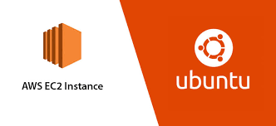
I. Amazon EC2
Amazon EC2 Instance Configuration
Amazon EC2 Instanc is a cloud server. With one account you can create and use multiple Amazon EC2 Instances. Amazon EC2 Instances are run on the same physical server and share memory, CPU, hard drive...

Slide 51
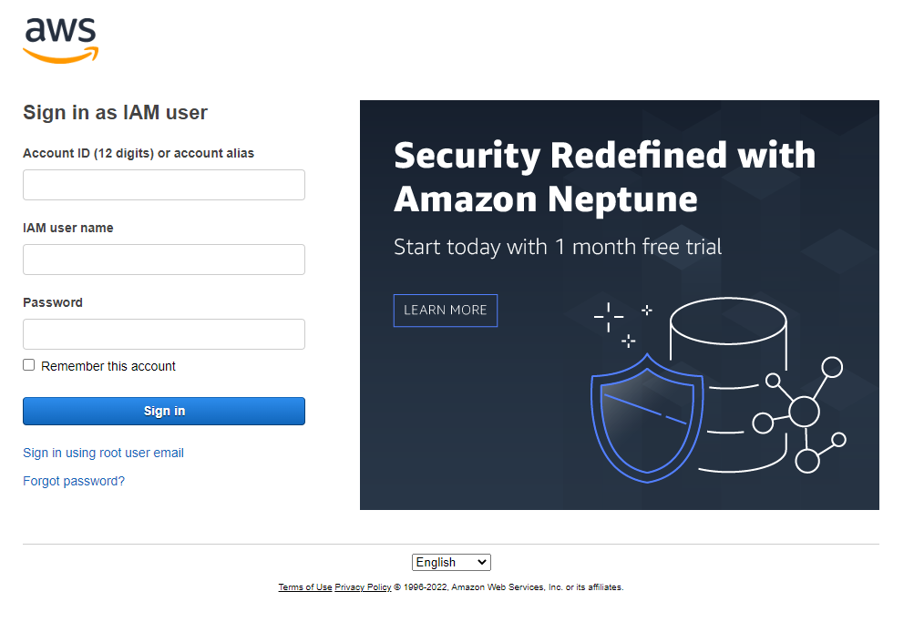
I. EC2 Instance Configuration
AWS
1. Sign in to the AWS Management Console and open the Amazon EC2 console at https://console.aws.amazon.com/ec2/

Slide 52
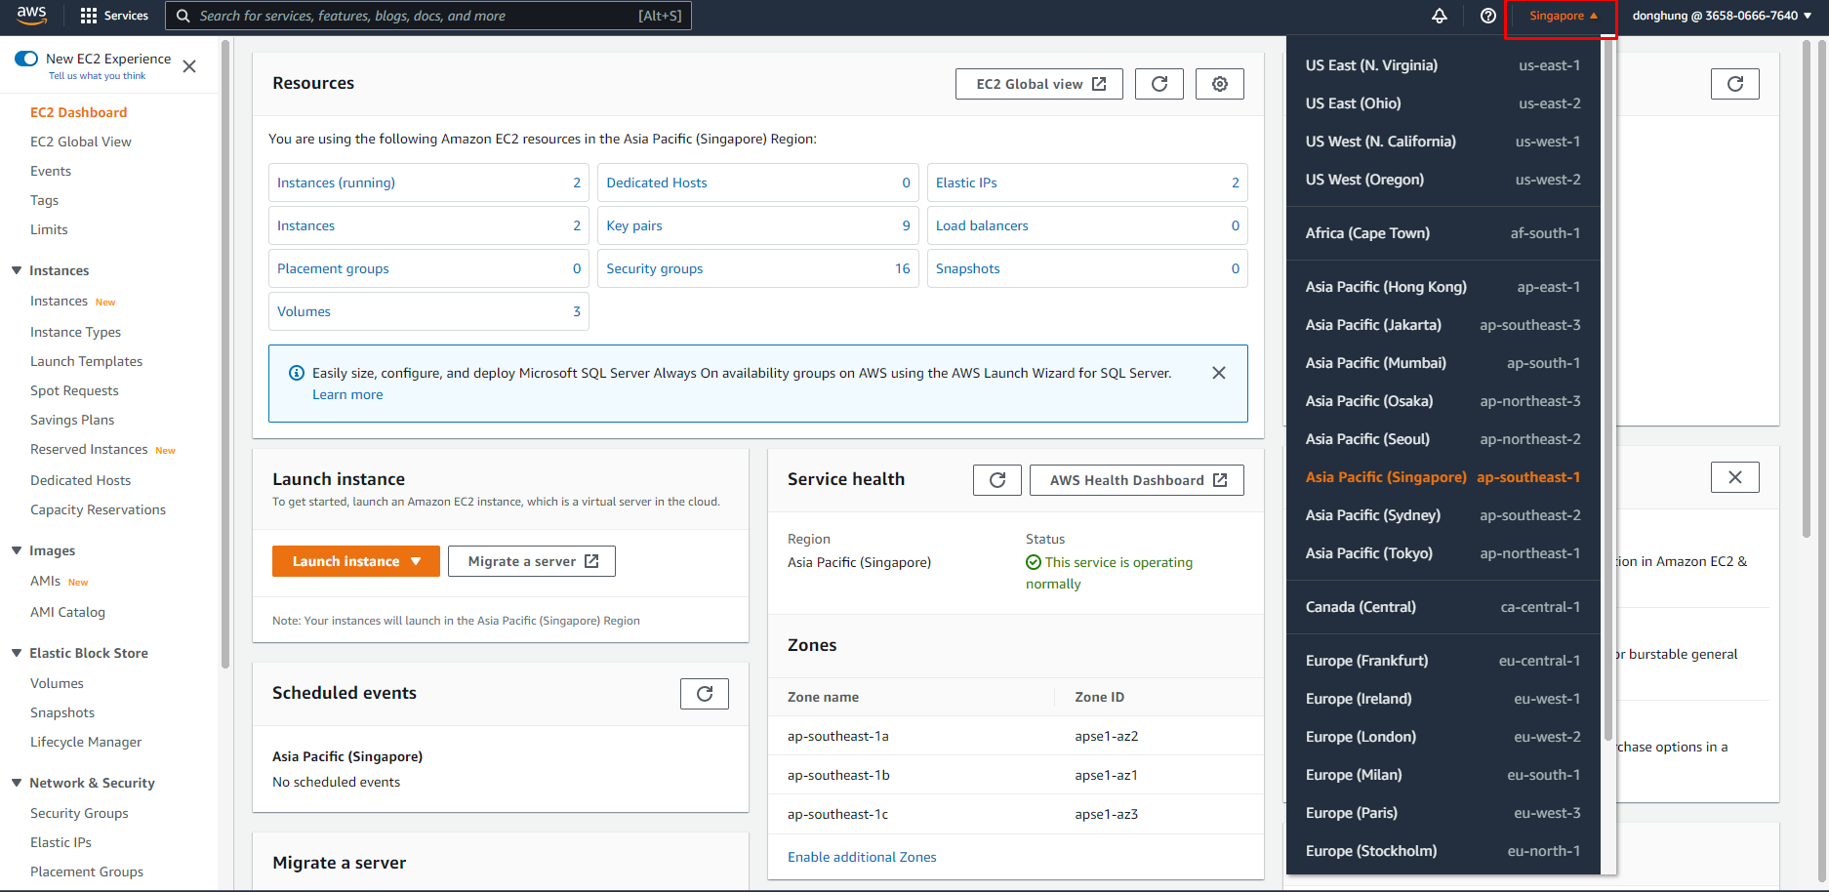
I. EC2 Instance Configuration
AWS
2. In the upper-right corner of the AWS Management Console, choose the AWS Region where you want to create the EC2 instance.

Slide 53
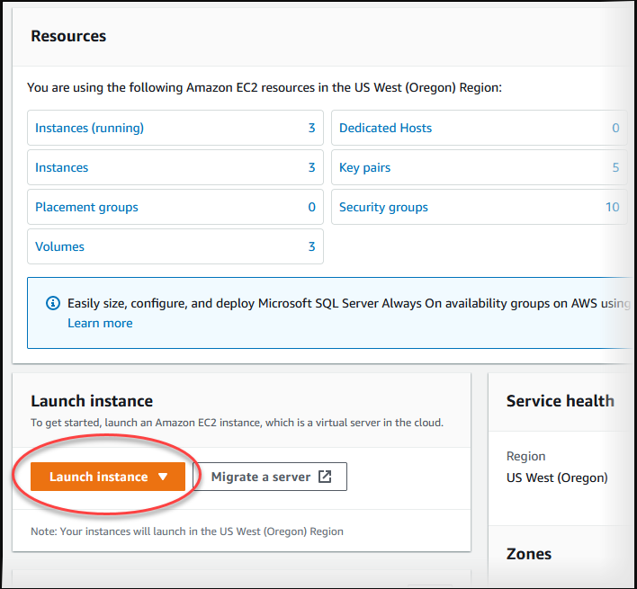
I. EC2 Instance Configuration
AWS
3. Choose EC2 Dashboard, and then choose Launch instance, as shown following.

Slide 54
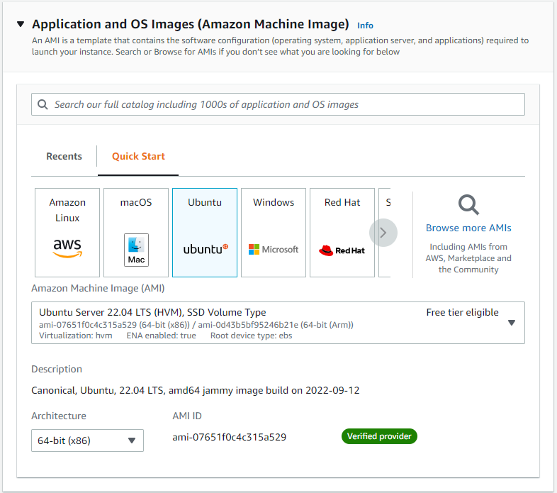
I. EC2 Instance Configuration
AWS
4. Make sure you have opted into the new launch experience.
5. Under Name and tags, for Name, enter the name what your want. My instance’name is “NGINX”
6 .Under Application and OS Images (Amazon Machine Image), choose OS and AMI. You should choose Ubuntu and Ubuntu Server 22.04 LTS

Slide 55
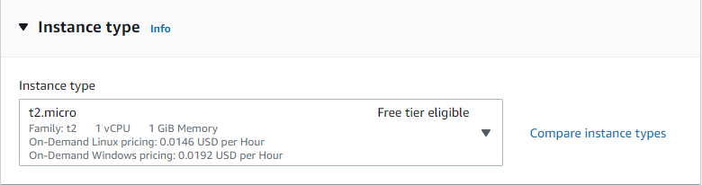
I. EC2 Instance Configuration
AWS
7. Under Instance type, you should choose t2.micro.

Slide 56
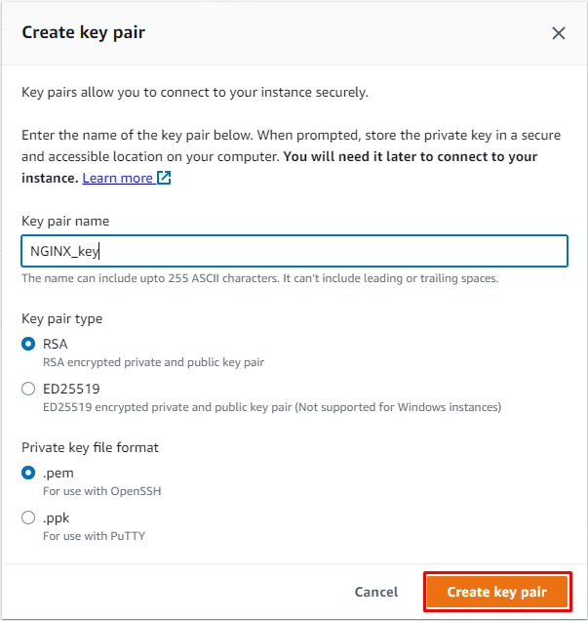
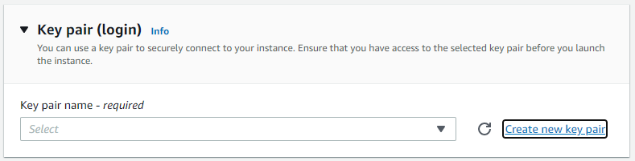
I. EC2 Instance Configuration
AWS
8. Under Key pair (login) choose Create new key pair and then use the Create key pair window to create it..
Remember you key pair name and it’s location.

Slide 57
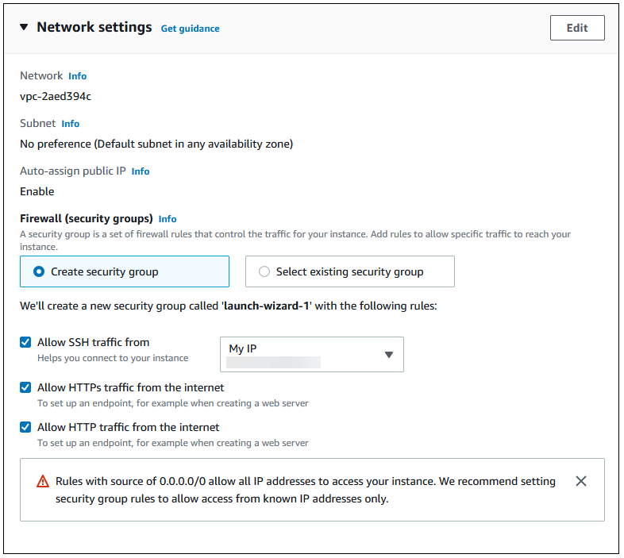
I. EC2 Instance Configuration
AWS
9. Under Network settings, set these values and keep the other values as their defaults:
For Allow SSH traffic from, choose the source of SSH connections to the EC2 instance.
You can choose My IP if the displayed IP address is correct for SSH connections.
Turn on Allow HTTPs traffic from the internet.
Turn on Allow HTTP traffic from the internet.

Slide 58
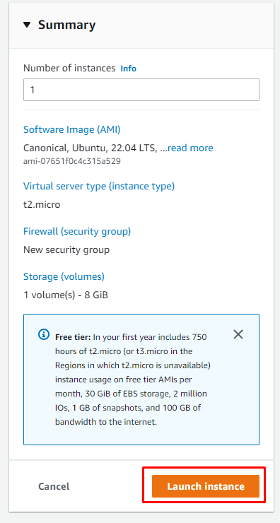
I. EC2 Instance Configuration
AWS
10. Leave the default values for the remaining sections.
11.Review a summary of your instance configuration in the Summary panel, and when you're ready, choose Launch instance.

Slide 59
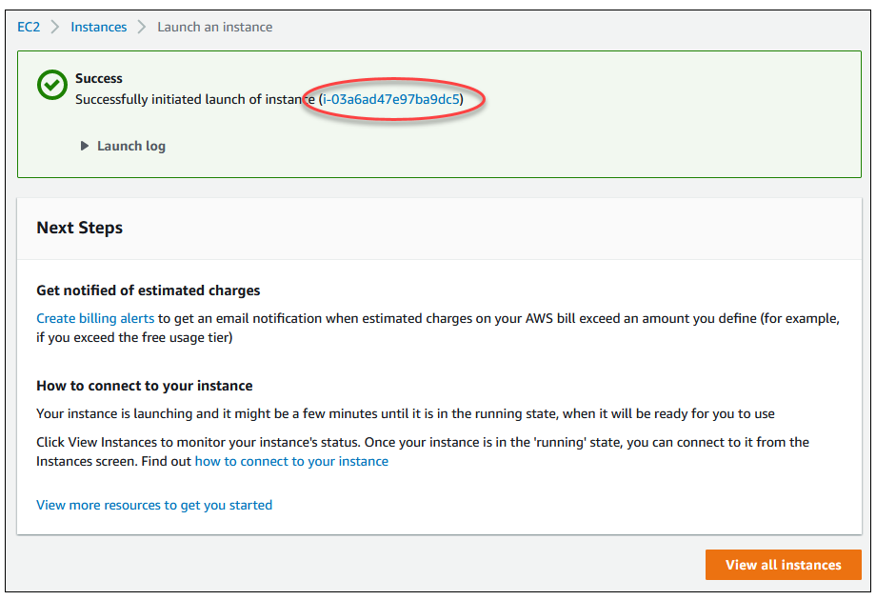
I. EC2 Instance Configuration
AWS
12. On the Launch Status page, shown following, note the identifier for your new EC2 instance, for example: i-03a6ad47e97ba9dc5

Slide 60
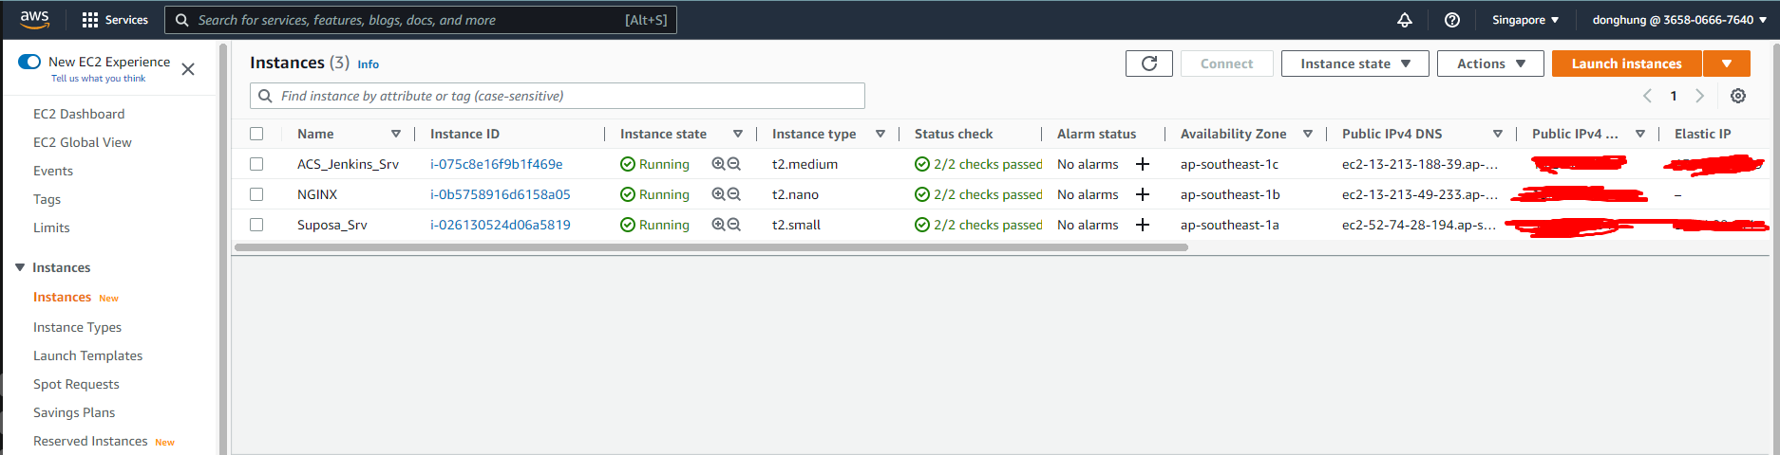
I. EC2 Instance Configuration
AWS
13. Choose View all instances to find your instance.
14. Wait until Instance state for your instance is Running.

Slide 61
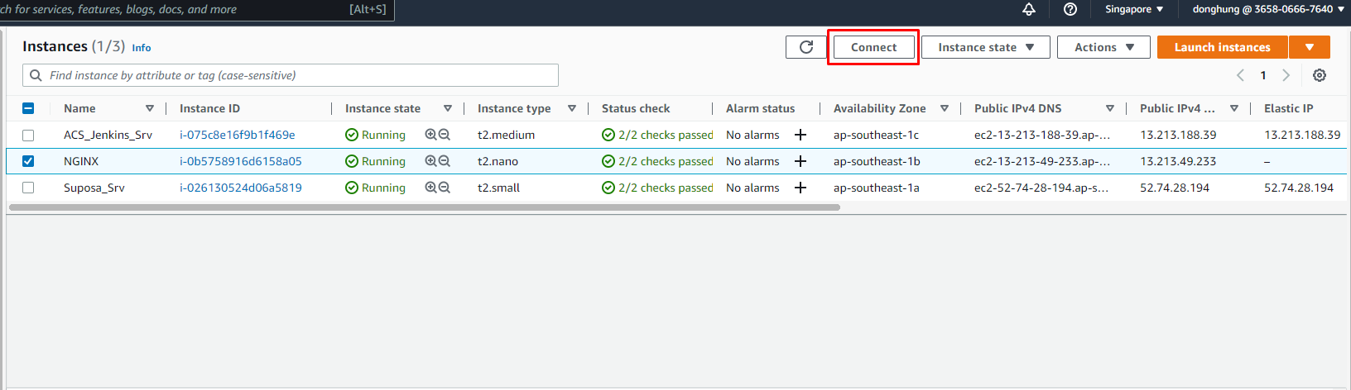
II. EC2 Webserver Configuration
AWS
15. Click the Connect button at the top of the screen. A window like the following pops up. Open the SSH client tab and follow the instructions to connect to the instance

Slide 62
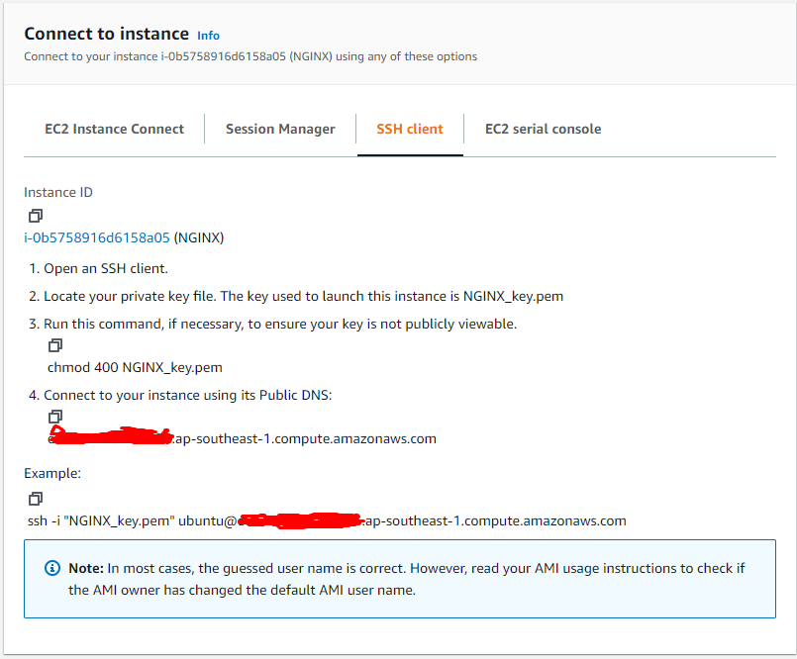
II. EC2 Webserver Configuration
AWS
15. Follow the command in this tab

Slide 63
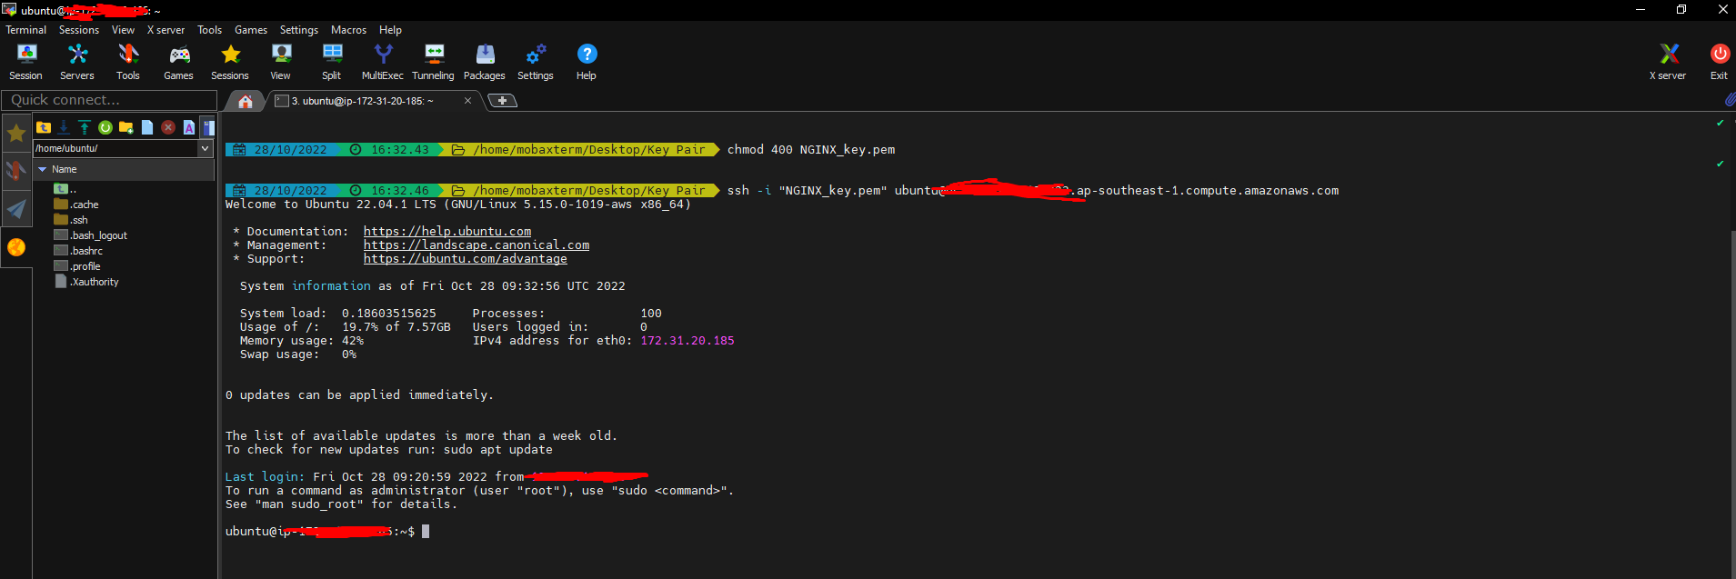
II. EC2 Webserver Configuration
AWS
16. If you use “Window”. Please download a ssh tool to connect Instance.
https://mobaxterm.mobatek.net/download.html
Open the browser at the folder containing the key pair file and execute the command in SSH Tab
Now, you have access to your instance

Slide 64
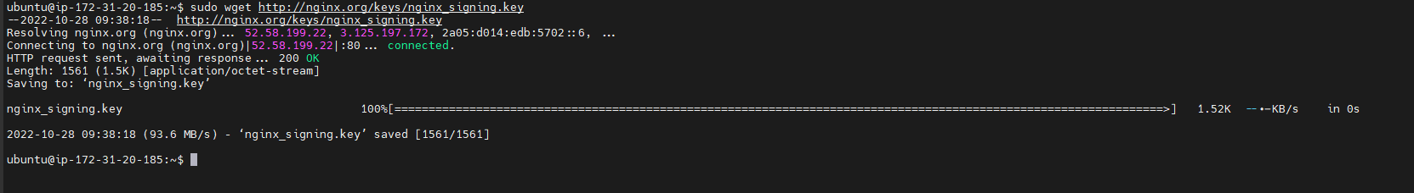
II. EC2 Webserver Configuration
AWS
17. Download the NGINX signing key:
sudo wget http://nginx.org/keys/nginx_signing.key

Slide 65
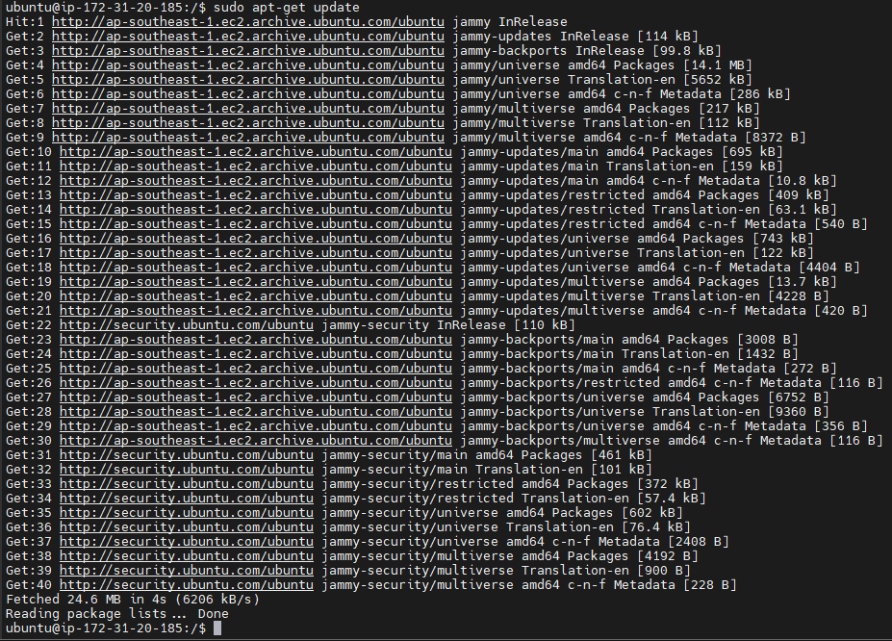
II. EC2 Webserver Configuration
AWS
18. Update software:
sudo apt-get update

Slide 66
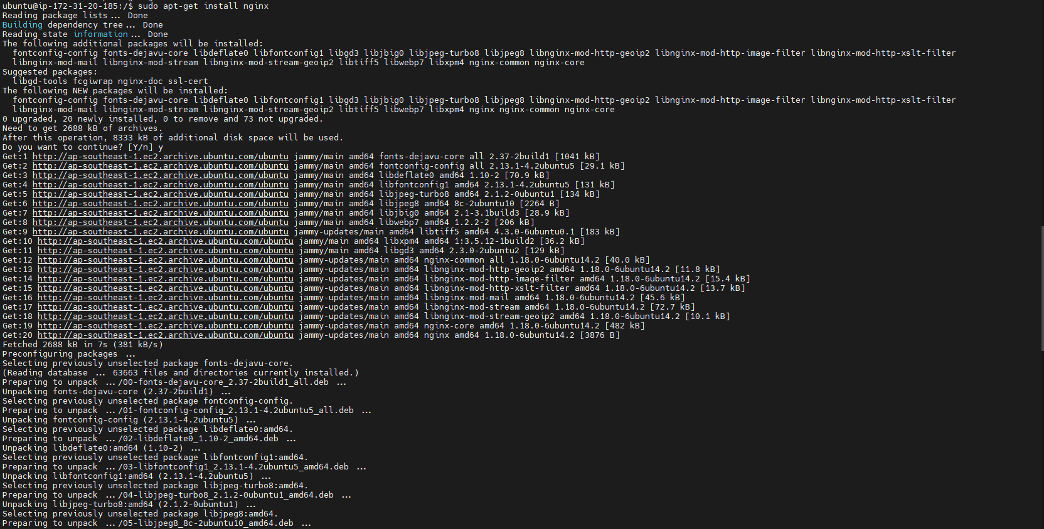
II. EC2 Webserver Configuration
AWS
19. Install NGINX:
sudo apt-get install nginx
Type Y when prompted.

Slide 67
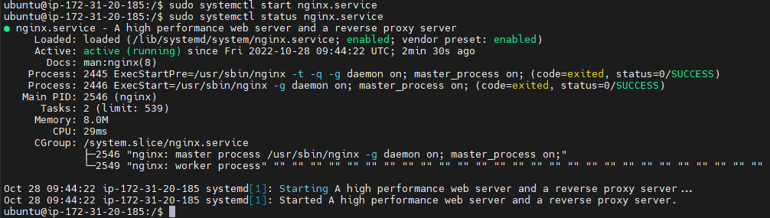
II. EC2 Webserver Configuration
AWS
20. Start NGINX
sudo systemctl start nginx.service
21. Check it’s status
sudo systemctl status nginx.service

